Slide 1
FUZZY CONTROLLER DESIGN
Dr.S.S.Thakur
Jabalpur Engineering College, Jabalpur (M.P.)

Slide 2
FUZZY CONTROLLER DESIGN
OUTLINES
DEVELOPMENT OF FUZZY TECHNOLOGY
APPLICATIONS OF FUZZY TECHNOLOGY
FUZZY SOFTWARE
FUZZY HARDWARE
FUZZY LOGIC
FUZZY INFERNCE SYSTEMS
FUZZY CONTROLLERS
FUZZY CONTROLLER FOR WATER HEATER

Slide 3
DEVELOPMENT OF FUZZY TECHNOLOGY
1965: Invention of fuzzy sets by Prof. Zadeh.
1972: Implementation of fuzzy industrial control by Mamdani.
1980: Commercial fuzzy KBS marked by Smith
1982: Fuzzy RDBMS developed by Buckels and Petry.
1985: Implementation of fuzzy KBS on chip by Togai.
1987: Sandai subway system based on fuzzy control.

Slide 4
DEVELOPMENT OF FUZZY TECHNOLOGY
1988: Fuzzy chips available commercially from Omran.
1989: Fuzzy home appliances start being sold in Japan.
1990: Fuzzy computer design by Yamkawa and manufactured by Omran.
1991: Fuzzy C-expert system design by Togai Infra Logic.

Slide 5
DEVELOPMENT OF FUZZY TECHNOLOGY
1991: Fuzzy microcontroller NLX-230 design by Neural Logic Corporation.
1991: Fuzzy logic tool kit for MATLAB developed by Math-works Inc.
1993: Neuro-fuzzy system developed by Buckley and Hayashi.
Fuzzy Logic Becomes a Standard Technology and Is Also Applied in Data and Sensor Signal Analysis, Business and Finance

Slide 6
APPLICATIONS OF FUZZY TECHNOLOGY
MATHEMATICS
  Fuzzy reasoning
  Fuzzy algebra
  Fuzzy topology
  Fuzzy graph theory
  Fuzzy logic.
CIVIL ENGINEERING
  Fuzzy logic based system for earth quake prediction
  Fuzzy logic based design evaluation system

Slide 7
APPLICATIONS OF FUZZY TECHNOLOGY
ELECTRICAL ENGINEERING
  Fuzzy control theory and applications
  Fuzzy logic based load forecasting system
ENVIRONMENTAL SCIENCE
  Fuzzy logic based weather prediction system
  Fuzzy logic based water quality control system
MEDICAL SCIENCE
  Fuzzy logic based diagnosis system

Slide 8
APPLICATIONS OF FUZZY TECHNOLOGY
COMPUTER SCIENCE AND APPLICATIONS
  Fuzzy expert system
  fuzzy data base system
  Fuzzy information retrieval system
  Fuzzy investment evaluation system
  Fuzzy cost benefit analysis system
  Fuzzy decision support system
  Fuzzy student evaluation system
  Fuzzy trading system

Slide 9
FUZZY SOFTWARE
FPL: Fuzzy programming language
FIDE: Fuzzy inference development environment
FUZZY TOOL KIT IN MATLAB
FRIL: Fuzzy Relational Inference Language
FUZ-C: Extension Of C
FUZZY TECH.: Fuzzy Technology

Slide 10
FUZZY HARDWARE
MOTOROLA 68HC12 MICROCONTROLLER
CE124 FUZZY LOGIC TRAINER
ST52 DURALOGIC MICROCONTROLLER
VY 86C570 FUZZY COPROCESSOR CHIP
FP1000 FUZZY COPROCESSOR

Slide 11
FUZZY SET
DEFINITION
Let X be the universe of discourse with the generic element of X denoted by x. A fuzzy subset A of X is characterized by a membership function μ_{A}: X→[0,1], which associate each member x of X a number μ_{A}(x) of closed interval [0 ,1] representing the grade of membership of x in X. The fuzzy set A is denoted as:
A={μ_{A} (x)/x : x∈X}

Slide 12
Fuzzy Logic
A branch of logic that uses degrees of membership
in sets rather than a strict true/false membership.

Slide 13

Linguistic Variables
Fuzzy logic quantifies and reasons about vague
or fuzzy terms that appear in our natural language
Fuzzy Terms are referred to as linguistic variables
Definition: Linguistic Variable
Term used in our natural language to describe some
concept that usually has vague or fuzzy values
Examples:
Linguistic Variable Typical Values
Temperature hot, cold
Height short, medium, tall
Speed slow, creeping, fast

Slide 14
Fuzzy Proposition
In classical logic, a proposition P is a linguistic or declarative statement contained within a universe of discourse U which is either true or false .In fuzzy logic a fuzzy proposition P is a statement involving some concept without clearly defined boundaries.
Let U be the set of ‘statements about a subject matter’ called the universe of discourse. A fuzzy proposition P is defined by a truth function T:U→[0 ,1] which assign a truth value in the closed interval [0 ,1 ] for each element(statement) x of U.
If the fuzzy proposition P is assign to a fuzzy subset A of U Then the truth value of a proposition denoted by T(P) is given by
T(P) = μ_{A}(x) , where 0 ≤ μ_{A} ≤ 1.
:
.

Slide 15
Logical connectives
Let P be a fuzzy proposition defined on a fuzzy subset A of U and Q be a fuzzy proposition defined on a fuzzy subset B of U.
Negation : ┐P: x is not A T(┐P) = 1 – T(P)
Disjunction : P۷Q: x is A or B T(P۷Q) = Max { T(P) ,T(Q)}
Conjunction: P۸Q : x is A and B T(P۸Q) = Min {T(P) ,T(Q)}
Implication: P→Q: x is A then x is B T(P→Q) = T(┐P۷Q)

Slide 16
Meanings of AND, OR, NOT in Fuzzy v. Boolean Logic
Fuzzy Logic
p AND q
  is TRUE, and has the smaller fuzzy value of p and q
p OR q
  is TRUE, and has the larger fuzzy value of p and q
NOT p
  is TRUE, and has the fuzzy value of 1 minus the value of p
Boolean Logic
p AND q
  TRUE if p and q are TRUE
  otherwise FALSE
p OR q
  FALSE if p and q are FALSE
  otherwise TRUE
NOT p
  FALSE if p is TRUE
  TRUE if p is FALSE
Notes:
As you can imagine, fuzzy values add complexity to reconciling the meaning of logical terms such as AND, OR, and NOT. The definitions of these terms in Boolean logic, in the left column, are straightforward and simple to understand. The definitions of the terms in the right column for Fuzzy logic might not be.
Let’s take our original temperature example (cool, warm, hot) and also consider a fuzzy set that manages the humidity of the room. This second set would consist of the terms (dry, moist, wet). Lets consider p to mean “the room is cool” and q to mean “the room is dry”.
First, we will discuss the meaning of AND. The expression “the room is cool AND the room is dry” is true to the smaller fuzzy value that “the room is cool” or “the room is dry”. So, if “the room is cool” has a value of 0.4 and “the room is dry” is 0.7, the “the room is cool AND the room is dry” has a fuzzy value of 0.4.
OR takes the larger fuzzy value. Therefore, “the room is cool OR the room is dry” has a fuzzy value of 0.7.
NOT takes the fuzzy value and subtracts it from one. So, if “the room is cool” has a fuzzy value of 0.4, then “the room is NOT cool” has a value of 0.6. However, do not confuse “NOT cool” to mean “hot”. In the binary world of Boolean logic, “NOT cool” and “hot” would be synonymous. In fuzzy logic, “NOT cool” and “hot” are very different.
We have constructed a short quiz to help reinforce this material. To take the quiz, click on the hyperlink labelled “Multiple Choice Test for Reinforcement”. This quiz should only take you a couple of minutes.

Slide 17
Example of fuzzy proposition
U = {low, below normal, above normal , high}
= { set of statements on the subject matter
“temperature of the chemical process” }.
Then
P =Temperature is cold
= {1/low , 0.6/below normal , 0/above normal ,0/high}
Q =Temperature is hot
= {0/low , 0.2/below normal , 0.8 /above normal ,1/high}
┐P = Temperature is not cold = < 0 , 0.4 , 1 , 1 >
┐Q =Temperature is not hot = < 1 , 1 , 0.2 , 0 >
P۷Q = Temperature is cold or hot = < 1, 0.6 , 0.8 ,1 >
P۸Q =Temperature is cold and hot = < 0 , 0.2 , 0 , 0 >

Slide 18
FUZZY INFERENCE SYSTEMS
A of the universe of discourse X and the fuzzy proposition Q defined on a fuzzy set B of the universe discourse Y. Then the implication P → Q Suppose that a fuzzy proposition P defined on a fuzzy set can be defined by the fuzzy relation R on XxY .
P → Q:IF x is A THEN y is B is equivalent to the fuzzy relation R=(AxB)∪(A^{c}xY)
whose membership function is defined by the following formula:
μR(x) = Max{ μA(x) ۸ μB(y) , 1-μA(x) }

Slide 19
Example
Let U = {low, below normal, above normal , high}
= { set of statements on the subject matter
“temperature of the chemical process” }.
V = {low, below normal, normal, above normal, high}
= { The set of statements on the subject matter
“ pressure of the chemical process” }.
P =Temperature is cold = {1/low , 0.6/below normal , 0/above normal ,0/high}
= < 1,0.6,0,0 > and
P’ =Temperature is hot = {0/low , 0.2/below normal , 0.8 /above normal ,1/high}
= < 0,0,0.8,1 >
Q = Pressure is low = {1/low , 0.8/below normal ,0.1/normal, 0/above normal ,0/high}
= < 1,0.8, 0.1,0,0 >
Q’ = Pressure is high = {0/low , 0/below normal ,0.1/normal, 0.8/above normal ,1/high}
= < 1,0.8, 0.1,0,0 >

Slide 20
Example
P → Q: IF Temperature is cold THEN Pressure is low is equivalent to the fuzzy relation R given below
L BN N AN H
L 1 .8 .1 0 0
BN .6 .6 .4 .4 .4 R = AN 1 1 1 1 1
H 1 1 1 1 1

Slide 21
Approximate Reasoning
Suppose we have a rule based format to represent fuzzy information. These rules are expressed in conventional antecedent-consequent form.
Rule1:IF x is A THEN y is B .
Where A and B represent fuzzy propositions(sets). Now suppose we introduce a new antecedent say A’ and we consider the following rule:
Rule 2: IF x is A’ THEN y is B’.
The consequent can be found from the composition operation as given below
B’ = A’•R = A’• (AxB)∪(AcxY)
where
R = (AxB)∪(AcxY)
and • is the max-min composition of the relations A’ and R.

Slide 22
Example
Let X= {1 ,2, 3, 4, 5, 6}
={set of statements on the subject matter
“height of a person in feet”}
Y= {10, 30 , 50 , 70, 90 ,110}
= { set of statements on the subject matter
“weight of a person in kg.”}.
Let the fuzzy propositions LONG and SHORT on X and HEAVY on Y are given below:
A = LONG ={ 0/1 ,0/2, 0.1/3 ,0.4/4, 0.8/5, 1/6}
A’=SHORT =(1/1 , 0.8/2 , 0.4/3 , 0.1/4 , 0/5 , 0/6}
B = HEAVY={0/10 , 0/30 , 0.20/50 , 0.4/70 ,0.8/90 , 1/110}.

Slide 23
Example
Rule1: IF height is A (LONG) THEN weight is B (HEAVY) .
Rule 2: IF height is A’(SHORT) THEN weight is B’.
The consequent B’ can be obtained by the formula :
B’ = A’•R=A’•(AxB)∪(AcxY).
1 1 1 1 1 1
1 1 1 1 1 1
= [ 1 0.8 0.4 0.1 0 0 ] • 0.9 0.9 0.9 0.9 0.9 0.9
0.6 0.6 0.6 0.6 0.6 0.6
0.2 0.2 0.2 0.4 0.8 0.8
0.2 0.2 0.2 0.4 0.8 0.8 B’= [ 1 1 1 1 1 1]

Slide 24
FUZZY CONTROLLERS

Slide 25
CONVENTIONAL CONTROL
Open-loop control is ‘blind’ to actual output
Closed-loop control takes account of actual output and compares this to desired output
Desired
Output
Input
Controller/
Amplifier
Process
Dynamics
Output
+
-
Measurement

Slide 26
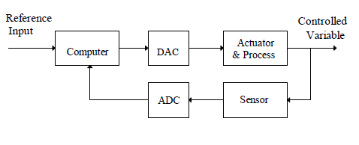
Digital Control System Configuration

Slide 27
Fuzzy Logic Control
Fuzzy control provides a formal methodology for representing, manipulating, and implementing a human’s heuristic knowledge about how to control a system.

Slide 28
Fuzzy Systems
Fuzzifier
Inference
Engine
Defuzzifier
Input
Output
Fuzzy
Knowledge base

Slide 29
Fuzzy Control Systems
Input
Fuzzifier
Inference
Engine
Defuzzifier
Plant
Output
Fuzzy
Knowledge base

Slide 30
Fuzzy Logic Control
Fuzzy controller design consist of turning intuitions, and any other information about how to control a system, into set of rules.
These rules can then be applied to the system.
If the rules adequately control the system, the design work is done.
If the rules are inadequate, the way they fail provides information to change the rules.

Slide 31
Components of Fuzzy system
The components of a conventional expert system and a fuzzy system are the same.
Fuzzy systems though contain `fuzzifiers’.
  Fuzzifiers convert crisp numbers into fuzzy numbers,
Fuzzy systems contain `defuzzifiers',
  Defuzzifiers convert fuzzy numbers into crisp numbers.

Slide 32
Conventional vs Fuzzy system

Slide 33
Fuzzy Control System
Steps involved in the creation of a rule based fuzzy system:
1. Identify the inputs and their ranges and name them.
2. Identify the outputs and their ranges and name them.
3. Create fuzzy membership function for each input and output.
4. Construct the rule base that the system will operate under
5. Decide how the action will be executed by assigning strengths to the rules
6. Combine the rules
7. Defuzzify the output

Slide 34
FUZZY LOGIC CONTROL
TYPE OF FUZZY CONTROLLERS
Mamdani
TSK (Takagi Sugeno Kang)
Tsukamoto

Slide 35
MAMDANI FUZZY MODELS
The most commonly used fuzzy inference technique is the so-called Mamdani method.
In 1975, Professor Ebrahim Mamdani of London University built one of the first fuzzy systems to control a steam engine and boiler combination.
Original Goal: Control a steam engine & boiler combination by a set of linguistic control rules obtained from experienced human operators.

Slide 36
Mamdani fuzzy inference
The Mamdani-style fuzzy inference process is performed in four steps:
Fuzzification of the input variables,
Rule evaluation;
Aaggregation of the rule outputs
Defuzzification.

Slide 37
Operation of Fuzzy System
Crisp Input
Fuzzification
Input Membership Functions
Fuzzy Input
Rule Evaluation
Rules / Inferences
Fuzzy Output
Defuzzification
Output Membership Functions
Crisp Output

Slide 38
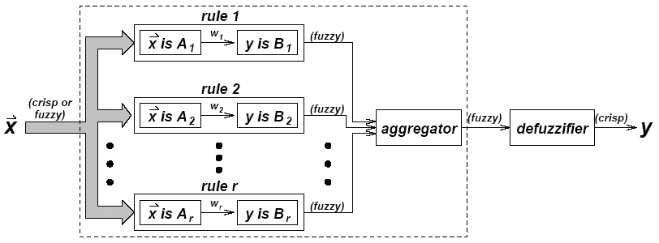
Inference Engine
Using If-Then type fuzzy rules converts the fuzzy input to the fuzzy output.

Slide 39
Simple two-input one-output problem
that includes three rules:
Rule: 1 Rule: 1
IF x is A3 IF project_funding is adequate
OR y is B1 OR project staffing is small
THEN z is C1 THEN risk is low
Rule: 2 Rule: 2
IF x is A2 IF project_funding is marginal
AND y is B2 AND project_staffing is large
THEN z is C2 THEN risk is normal
Rule: 3 Rule: 3
IF x is A1 IF project_funding is inadequate
THEN z is C3 THEN risk is high

Slide 40
Step 1: Fuzzification
Take the crisp inputs, x1 and y1 (project funding and project staffing)
Determine the degree to which these inputs belong to each of the appropriate fuzzy sets.
project funding
project staffing

Slide 41
Step 2: Rule Evaluation
take the fuzzified inputs, μ_{(x=A1)} = 0.5, μ_{(x=A2)} = 0.2, μ_{(y=B1)} = 0.1 and μ_{(y=B2)} = 0.7
apply them to the antecedents of the fuzzy rules.
If a given fuzzy rule has multiple antecedents, the fuzzy operator (AND or OR) is used to obtain a single number that represents the result of the antecedent evaluation. This number (the truth value) is then applied to the consequent membership function.

Slide 42
Step 2: Rule Evaluation
To evaluate the disjunction of the rule antecedents, we use the OR fuzzy operation. Typically, fuzzy expert systems make use of the classical fuzzy operation union:
    μ_{A}∪_{B}(x) = max [μ_{A}(x), μ_{B}(x)]
Similarly, in order to evaluate the conjunction of the rule antecedents, we apply the AND fuzzy operation intersection:
    μ_{A}∩_{B}(x) = min [μ_{A}(x), μ_{B}(x)]

Slide 43
Mamdani-style rule evaluation

Slide 44
Now the result of the antecedent evaluation can be applied to the membership function of the consequent.
There are two main methods for doing so:
◦ Clipping
◦ Scaling
The most common method is to cut the consequent membership function at the level of the antecedent truth.

Slide 45
This method is called clipping (Max-Min Composition) .
  The clipped fuzzy set loses some information.
  Clipping is still often preferred because:
    it involves less complex and faster mathematics
    it generates an aggregated output surface that is easier to defuzzify.

Slide 46
While clipping is a frequently used method, scaling (Max-Product Composition) offers a better approach for preserving the original shape of the fuzzy set.
The original membership function of the rule consequent is adjusted by multiplying all its membership degrees by the truth value of the rule antecedent.
This method, which generally loses less information, can be very useful in fuzzy expert systems.

Slide 47
Clipped and scaled membership functions
Max-Min Composition
Max-Product Composition

Slide 48
Step 3: Aggregation of The Rule Outputs
Aggregation is the process of unification of the outputs of all rules.
We take the membership functions of all rule consequents previously clipped or scaled and combine them into a single fuzzy set.

Slide 49
Aggregation of the rule outputs

Slide 50
Step 4: Defuzzification
Fuzziness helps us to evaluate the rules, but the final output of a fuzzy system has to be a crisp number.
The input for the defuzzification process is the aggregated output fuzzy set and the output is a single number.

Slide 51
There are several defuzzification methods, but probably the most popular one is the centroid technique.
It finds the point where a vertical line would slice the aggregate set into two equal masses. Mathematically this centre of gravity (COG) can be expressed as:

Slide 52
Centroid defuzzification method finds a point representing the centre of gravity of the fuzzy set, A, on the interval, ab.
A reasonable estimate can be obtained by calculating it over a sample of points.

Slide 53
Centre of gravity (COG):

Slide 54
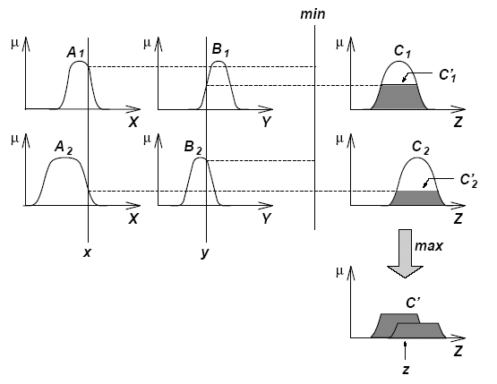
The Reasoning Scheme
Max-Min Composition is used.

Slide 55
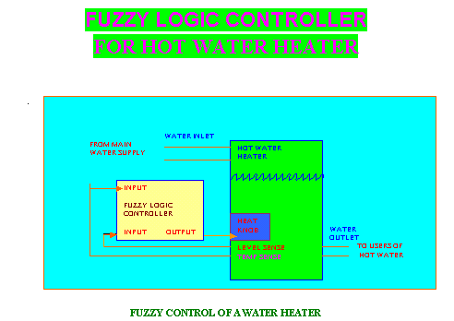

Slide 56
FUZZY CONTROLLER FOR WATER HEATER
HEAT KNOB (0 - 10) :
To Control The Heating Element Power
(0 =heating element turned off)
SENSORS:
TEMPSENSE (0 - 125) : Temperature of Water
LEVELSENSE (0 - 10): Water Level in the Tank
( 0 =Empty , 10=Full)

Slide 57
FUZZY CONTROLLER FOR WATER HEATER
THE DESIGN OBJECTIVE
Keep the water temperature as close to 80 ⁰ C as possible, in spite of changes in the water flowing out of the tank, and of the cold water flowing into the tank.

Slide 58
FUZZY CONTROLLER FOR WATER HEATER
UNIVERSE OF DISCOURSE
FOR INPUTS AND OUTPUTS
NAME | INPUT/OUTPUT | MINIMUM VALUE | MAXIMUM VALUE
LEVELSENSE | INPUT | 0 | 10
HEATKNOB | OUTPUT | 0 | 10
TEMPSENSE | INPUT | 0 | 125

Slide 59
FUZZY CONTROLLER FOR WATER HEATER
FUZZIFICATION OF INPUTS
Use triangular membership functions to fuzzify the inputs LEVELSENSE and TEMPSENSE.
Symmetrically distribute the fuzzified values across the universe of discourse.
Use an odd number of fuzzy sets for each variable so that some set is assured to be in middle.
•Overlap adjacent sets ( by 15% to 25% typically).

Slide 60
FUZZY CONTROLLER FOR WATER HEATER
FUZZIFICATION OF INPUTS
Both the input variables LEVELSENSE and TEMPSENSE are restricted to positive values .
Use the following fuzzy sets to describe LEVELSENSE and TEMPSENSE :
VERY LOW
LOW
NORMAL
HIGH
VERY HIGH

Slide 61
FUZZY VARIABLE RANGES FOR LEVELSENSE
CRISP INPUT RANGE | FUZZY VARIABLE
0 -2 | VERY LOW
1.5 –4 | LOW
3-7 | NORMAL
6-8.5 | HIGH
7.5-10 | VERY HIGH

Slide 62
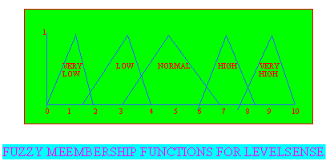
FUZZY CONTROLLER FOR WATER HEATER

Slide 63
FUZZY VARIABLE RANGES FOR TEMPSENSE
CRISP INPUT RANGE | FUZZY VARIABLE
0 -20 | VERY LOW
10-35 | LOW
30-75 | NORMAL
60-95 | HIGH
85-125 | VERY HIGH

Slide 64
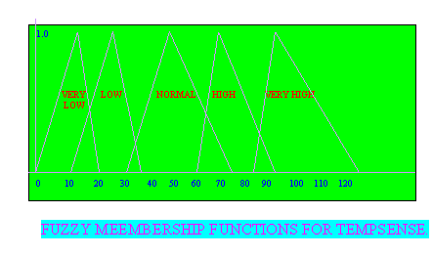
FUZZY MEMBERSHIP FUNCTIONS FOR TEMP SENSE

Slide 65
SET UP FUZZY MEMBERSHIP FUNCTIONS
FOR THE OUTPUT
FUZZY VARIABLE RANGES FOR HEATKNOB
CRISP INPUT RANGE | FUZZY VARIABLE
0 -2 | VERY LOW
1.5-4 | LOW
3-7 | NORMAL
6-8.5 | HIGH
7.5-10 | VERY HIGH

Slide 66
FUZZY MEMBERSHIP FUNCTIONS
FOR THE OUTPUT

Slide 67
CREATE A FUZZY RULE BASE
When the temperature is LOW, the heat knob should be set higher than when the temperature is HIGH.
When the volume of water is LOW , the heat knob does not need to be as high as when the volume of water is HIGH.

Slide 68
FUZZY RULE BASE
SENSE TEMP SENSE LEVEL | VERY LOW | LOW | NORMAL | HIGH | VERY HIGH
VERY LOW | NORMAL | LOW | VERY LOW
LOW | HIGH | NORMAL | VERY LOW | VERY LOW
NORMAL | VERY HIGH | HIGH | NORMAL | VERY LOW
HIGH | VERY HIGH | HIGH | HIGH | LOW
VERY HIGH | VERY HIGH | HIGH | HIGH | NOLMAL

Slide 69
CREATING IF-THEN RULES
Translate the table entries into If-Then Rules.
RULE-1 : IF SENSETEMP IS VERY LOW AND SENSELEVEL IS VERY LOW. THEN SET HEATKNOB TO NORMAL.
RULE-2 : IF SENSETEMP IS VERY LOW AND SENCE LEVEL IS LOW THEN SET HEATKNOB TO HIGH.
RULE-3: IF SENSETEMP IS VERY LOW AND SENSELEVEL IS NORMAL THEN SET HEATKNOB TO VERY HIGH.
RULE-4: IF SENSETEMP IS VERYLOW AND SENSELEVEL IS HIGH THEN SET HEATKNOB TO VERY HIGH.
RULE-5: IF SENSETEMP IS VERY LOW AND SENSELEVEL IS VERY HIGH THEN SET HEATKNOB TO VERY HIGH.
Notes:
CREATING IF-THEN RULES
We can now translate the table entries into If-Then Rules. We take these directly from table
RULE-1 : IF SENSETEMP IS VERY LOW AND SENSELEVEL IS VERY LOW. THEN SET HEATKNOB TO NORMAL.
RULE-2 : IF SENSETEMP IS VERY LOW AND SENCE LEVEL IS LOW THEN SET HEATKNOB TO HIGH.
RULE-3: IF SENSETEMP IS VERY LOW AND SENSELEVEL IS NORMAL THEN SET HEATKNOB TO VERY HIGH.
RULE-4: IF SENSETEMP IS VERYLOW AND SENSELEVEL IS HIGH THEN SET HEATKNOB TO VERY HIGH.
RULE-5: IF SENSETEMP IS VERY LOW AND SENSELEVEL IS VERY HIGH THEN SET HEATKNOB TO VERY HIGH.

Slide 70
CREATING IF-THEN RULES
RULE-5: IF SENSETEMP IS VERY LOW AND SENSELEVEL IS VERY HIGH THEN SET HEATKNOB TO VERY HIGH.
RULE-6: IF SENSETEMP IS LOW AND SENSELEVEL IS VERY LOW THEN SET HEATKNOB TO LOW.
RULE-7: IF SENSETEMP IS LOW AND SENSELEVEL IS LOW THEN SET HEATKNOB TO NORMAL.
RULE-8: IF SENSETEMP IS LOW AND SENSELEVEL IS NORMAL THEN SET HEATKNOB TO HIGH.
RULE-9: IF SENSETEMP IS LOW AND SENSELEVEL IS HIGH THEN SET HEATKNOB TO HIGH.

Slide 71
DEFUZZIFY THE OUTPUTS
Assume that at a particular point in time
LEVELSENSE = 7.0 and TEMPSENSE = 65
The membership values of fuzzy output are :
CRISP INPUT VALUES | MEMBERSHIP VALUES OF FUZZY OUTPUT
 | VERY LOW | LOW | NORMAL | HIGH | VERY HIGH
LEVEL SENSE = 7.0 | 0 | 0 | 0.4 | 0.6 | 0
TEMP SENSE = 65 | 0 | 0 | 0.75 | 0.25 | 0

Slide 72
DEFUZZIFY THE OUTPUTS
By using the fuzzy rule base and the strengths assigned previously, we find the rules recommended the following output values ( with strengths) for HEATKNOB:
IF TEMPSENSE = NORMAL(0.75) AND LEVELSENSE = NORMAL (0.4) THEN HEATKNOB = NORMAL(0.4)
Firing strength = (0.75) ^ (0.4) = 0.4
IF TEMPSENSE =HIGH (0.25) AND LEVELSENSE = NORMAL(0.4) THEN HEATKNOB = VERY LOW(0.25)
Firing strength = (0.25) ^ (0.4) = 0.25
IF TEMPSENSE = NORMAL (0.75) AND LEVELSENSE = HIGH (0.6) THEN HEATKNOB = HIGH (0.6)
Firing strength = (0.75) ^ (0.6) =0.6
TEMPSENSE = HIGH (0.75) AND LEVELSENSE = HIGH (0.6) THEN HEATKNOB = LOW (0.25)
Firing strength = (0.25) ^ (0.6) =0.25

Slide 73
FUZZY OR METHOD OF DEFUZZIFICATION.
In this method we use a disjunction or maximum operator to combine the values.
The crisp output value can be obtain after the multiplied by range of the output variable.
(0.4) V (0.25) V (0.6) V(0.25) =0.6
Crisp output value for HEATKNOB = (0.6) *(10) = 6.0

Slide 74
CENTROID METHOD OF DEFUZZIFICATION.
We use the strength value and fill in the particular triangular membership function to that strength level. For example, for the first rule , we fill the triangular membership function, NOLMAL to the 0.4 level We then cut of the top of the triangle (above 0.4) . Next we do the same for the other rules. Finally we align the truncated figures as shown in the following figure and combine them according to the overlap composition method. The overlap method simplify superimposes all of the truncated triangles on to the same area.. In order to get a crisp value, we take the centriod of the resulting figure . In this example ,crisp output value for HEATKNOB = 5.2.

Slide 75
1
0.6
0 1 2 3 4 5 6 7 8 9 10

